Slide 1
MMS in RDF
Blake Regalia

Slide 2
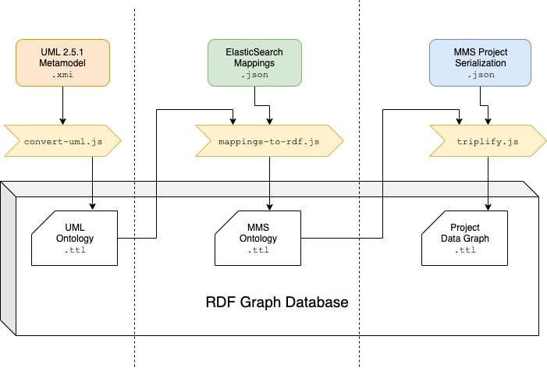
1

Slide 3
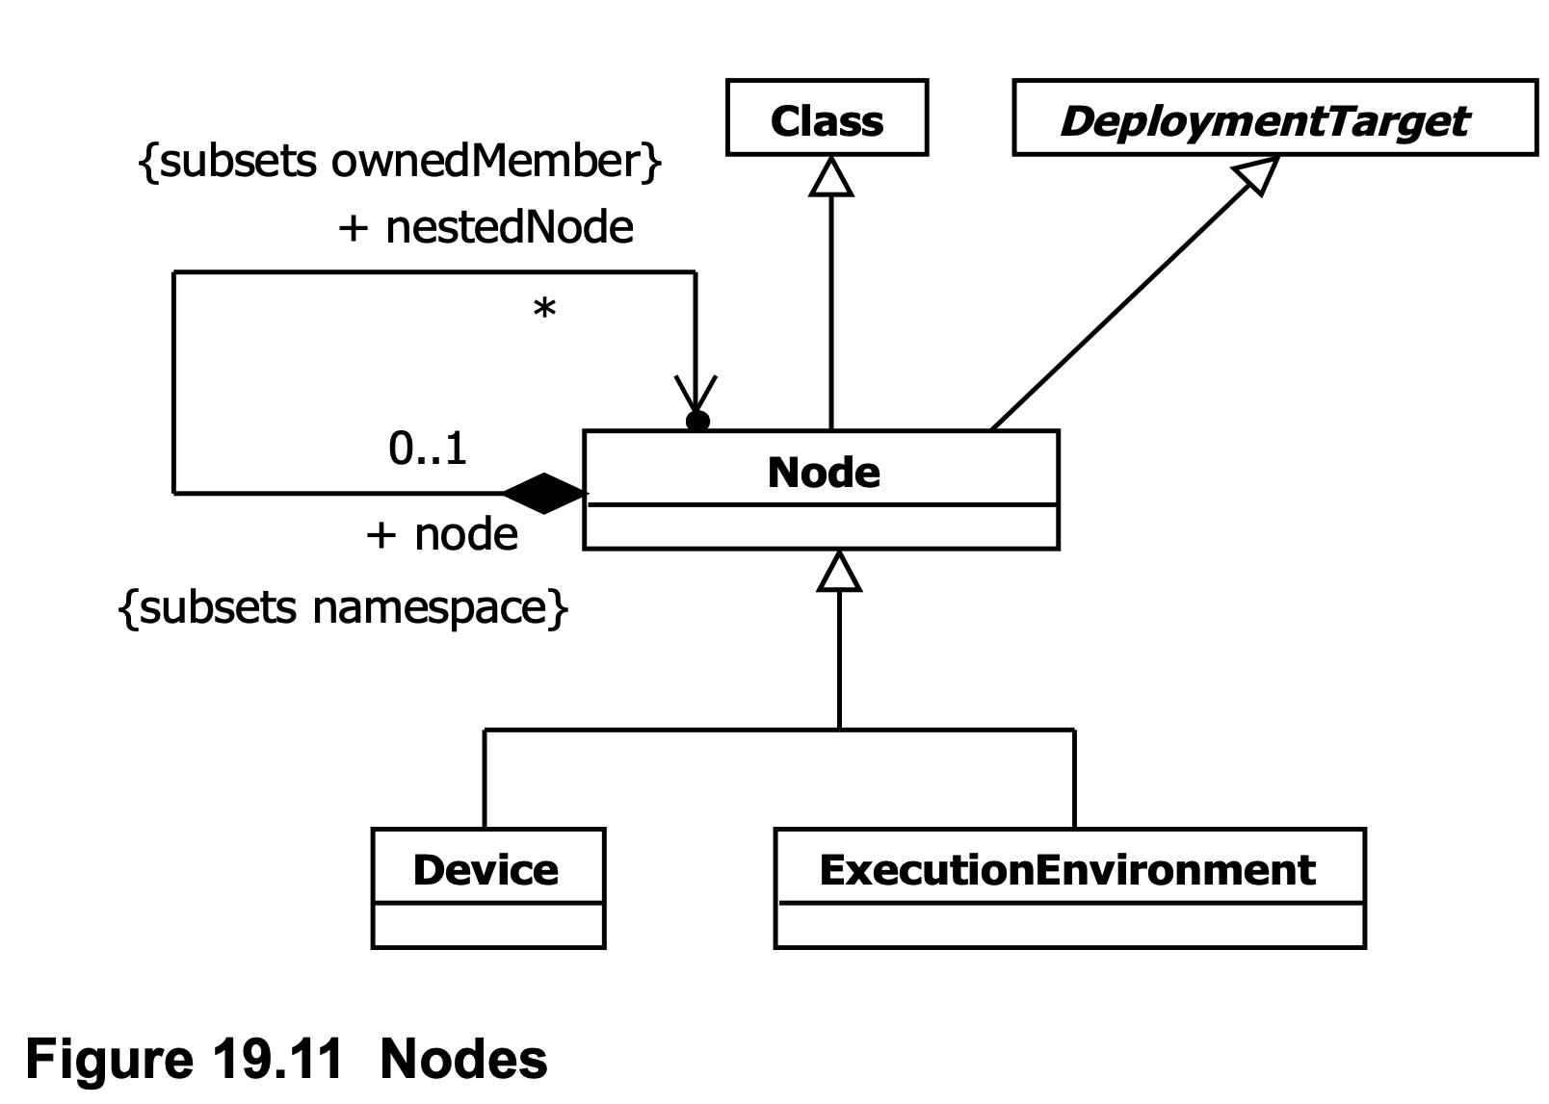
UML Metamodel Excerpt: ‘Nodes’

Slide 4
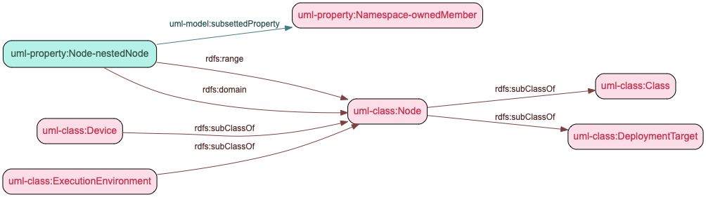
UML ‘Nodes’ Represented in RDF

Slide 5
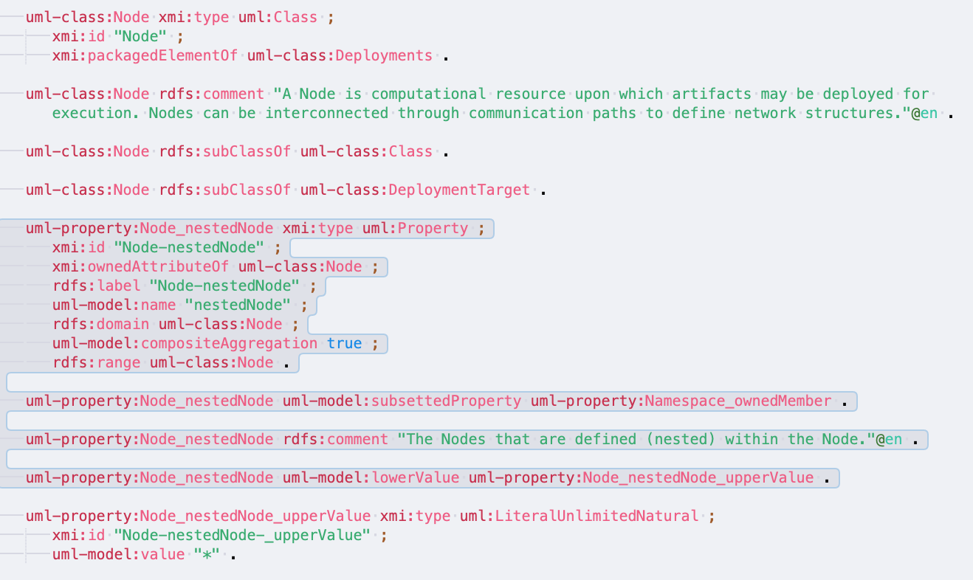

Slide 6
1

Slide 7
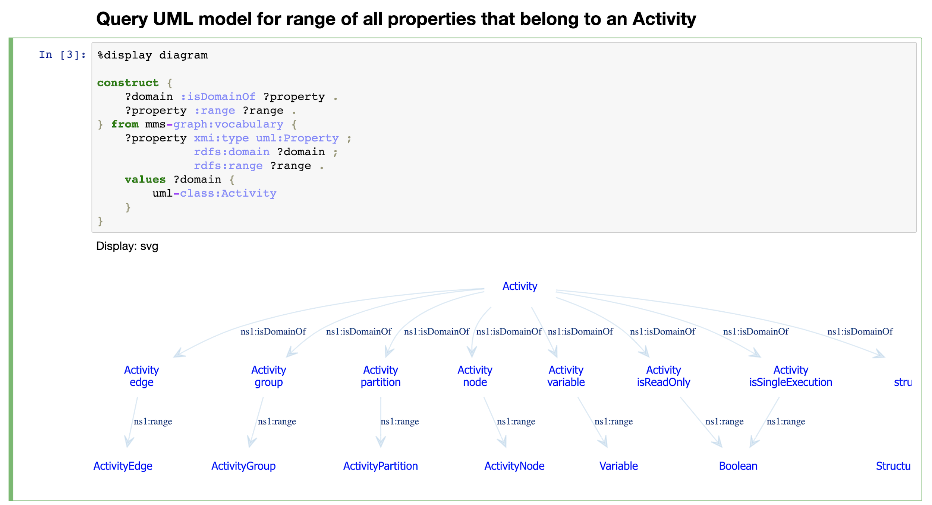

Slide 8
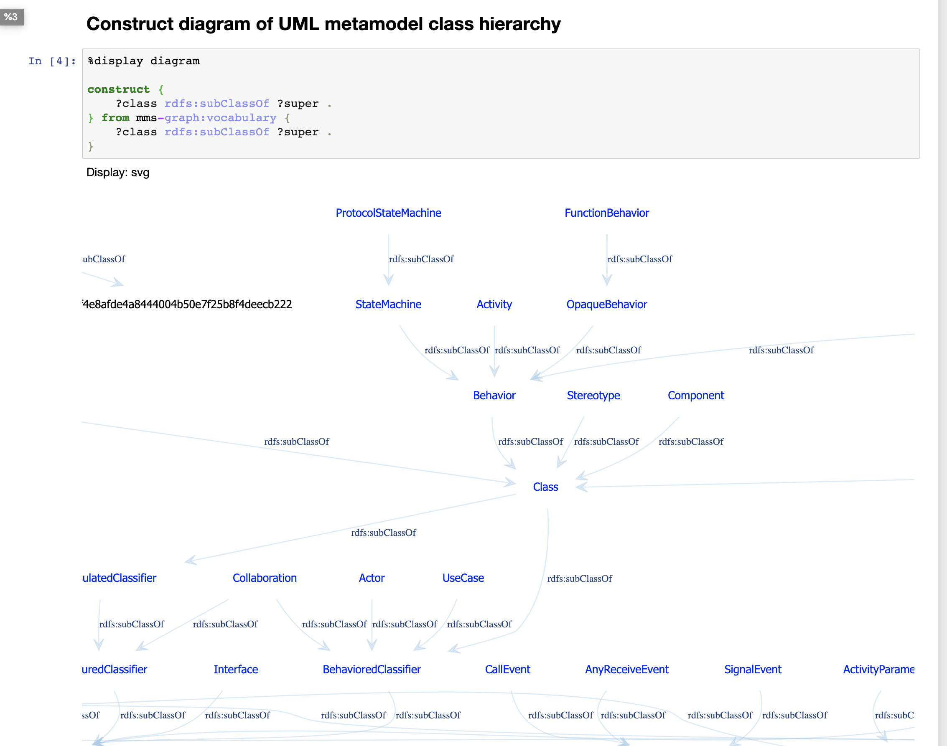

Slide 9
3

Slide 10
Model Element Data
The input data source is MMS’ serialization of model elements in JSON.
Keys of JSON objects represent either:
some UML property -- such as the keys “isAbstract” or “targetIds”.
or some derived property including metadata about the commit such as: who and when created or last modified the element, the commit id, the branch, etc.
Need to have knowledge of serialization’s structure in order to transform model element data into RDF in a way that is conformant with generated UML ontology.

Slide 11
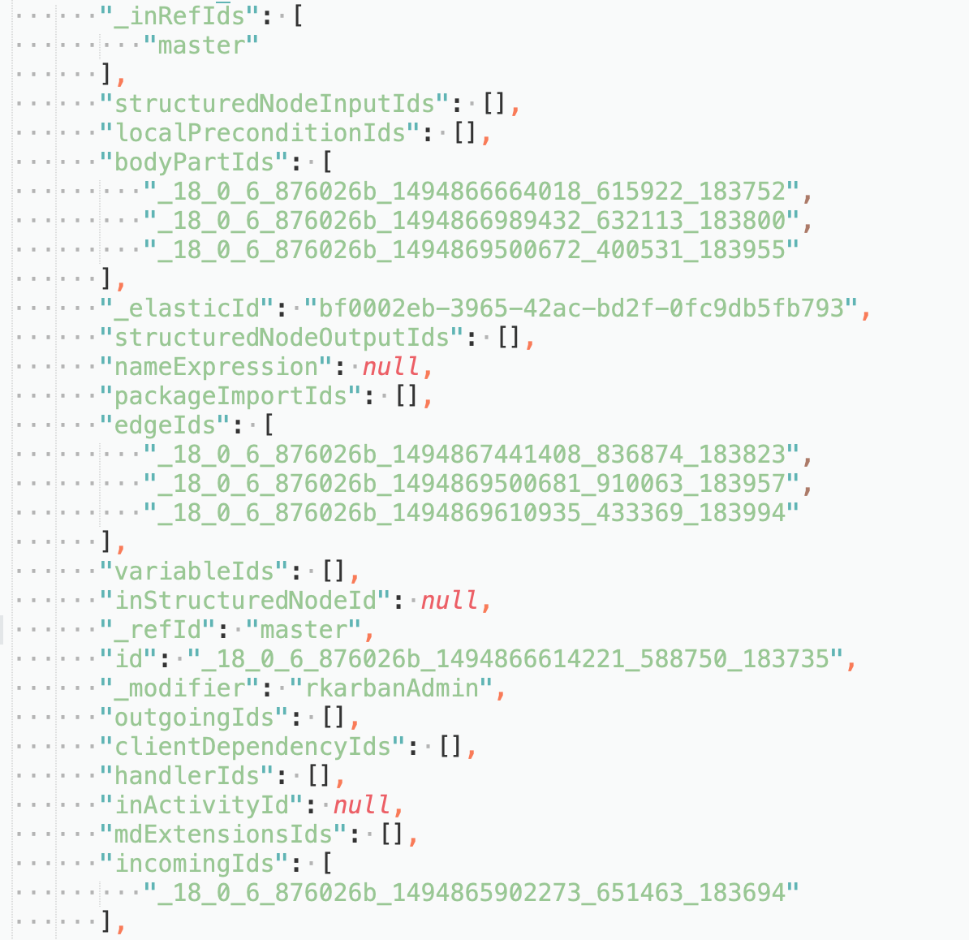

Slide 12
2

Slide 13
Deriving ‘MMS Ontology’: a UML Ontology Extension
Keeping the UML Ontology as is, define a new RDF property for each ‘relation’ that arises from applying the ElasticSearch mapping template.
A ‘relation’ in this case represents either:
a direct alias of a UML property -- e.g., ‘Transition-source’ => ‘sourceVertex’
a reification of a UML property to contain either a set or list of objects.
or a derived property (such as metadata about the commit) that does not exist in the UML metamodel.

Slide 14
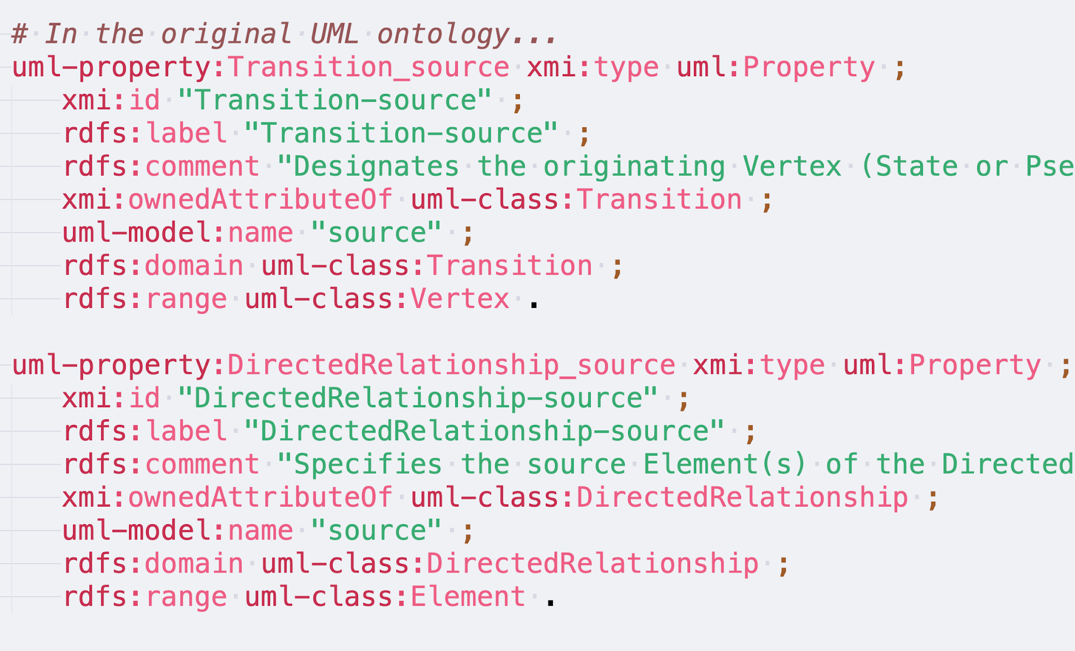
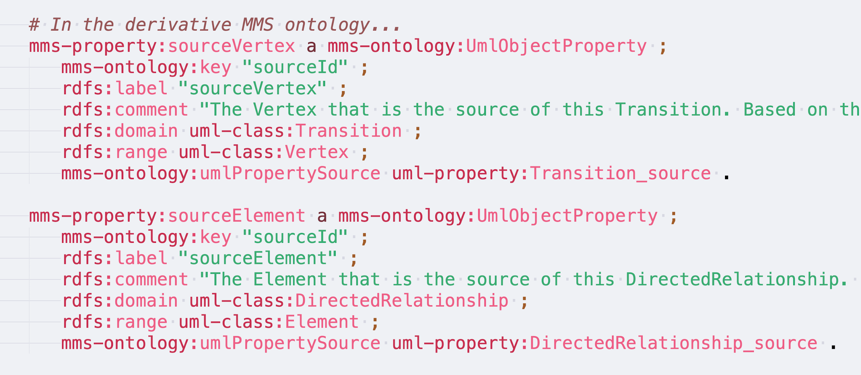
Directly Aliasing UML Properties

Slide 15
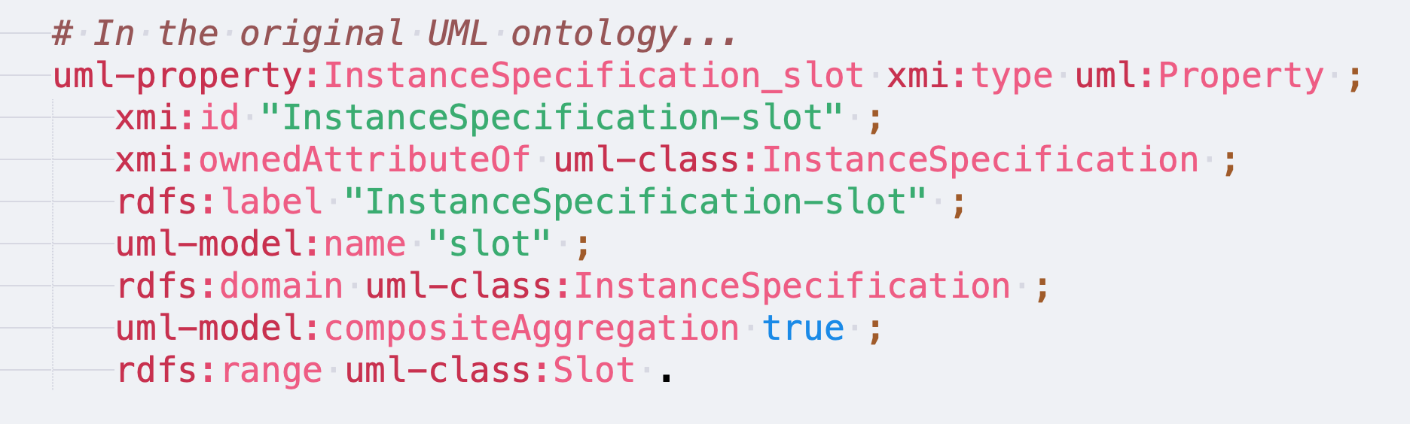
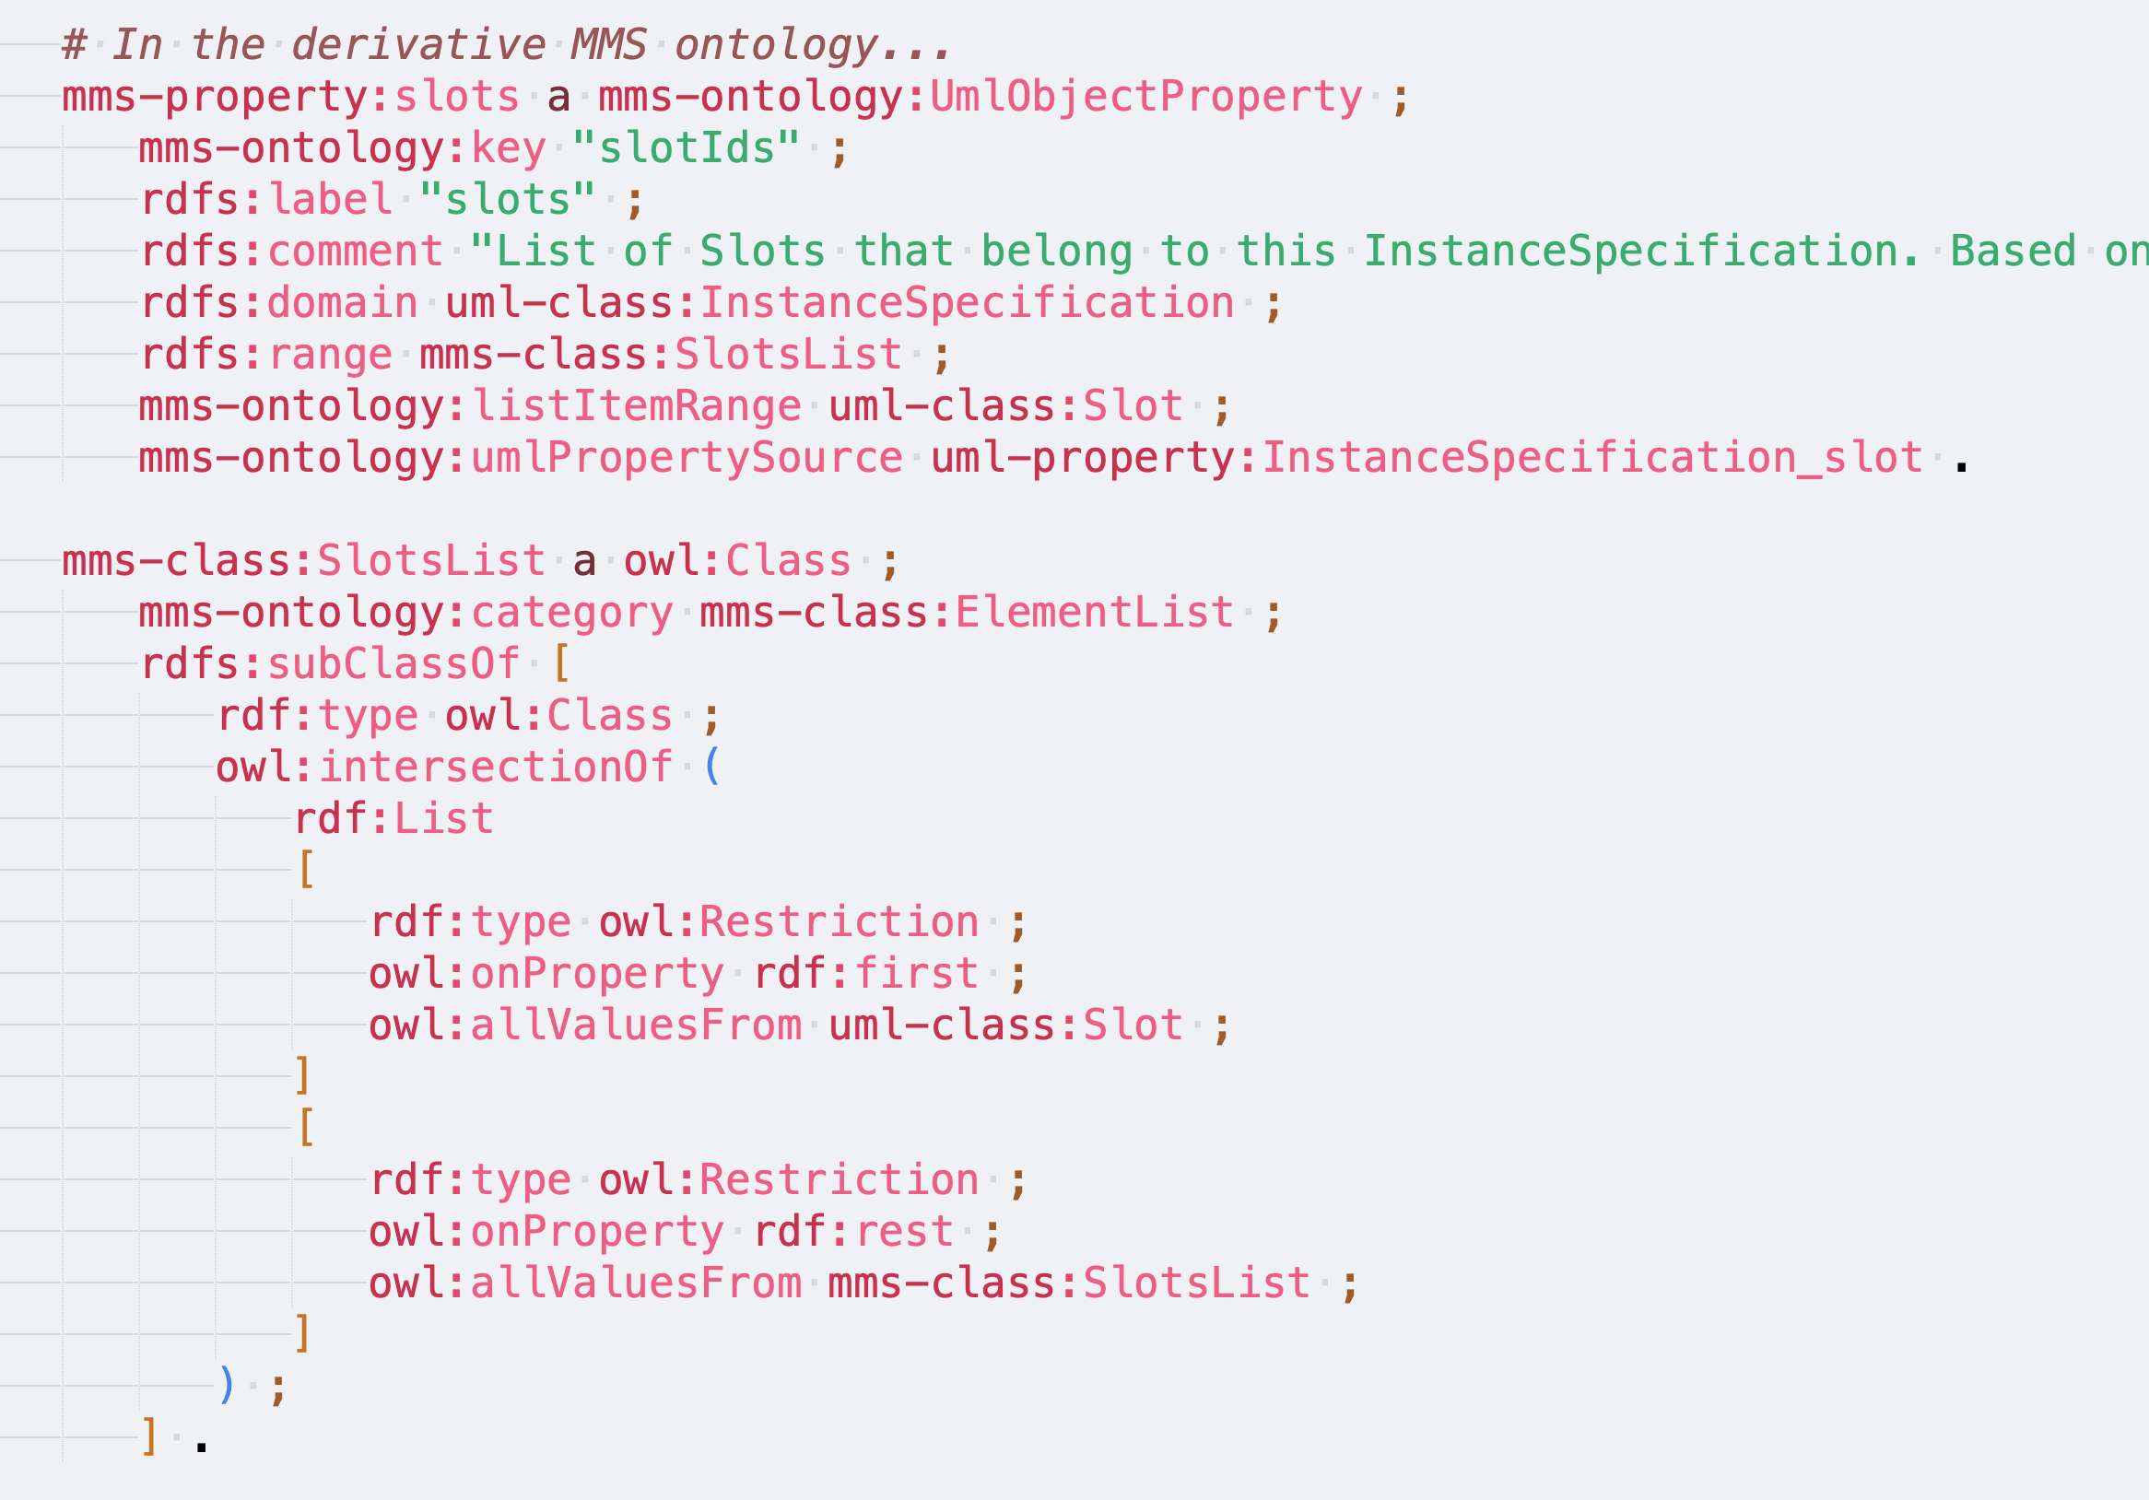
Reified UML Properties to Sets/Lists

Slide 16
Reified UML Properties to Sets/Lists cont’d
The need for a container is inferred from the “Ids” suffix of the mapping key label.
A new class is created (e.g., “SlotsList”) which defines a list of elements that must be of the given type (e.g., “Slot”).
Together with the range of the reified property, these assertions will enable validation of instance data in the eventual project graph.

Slide 17
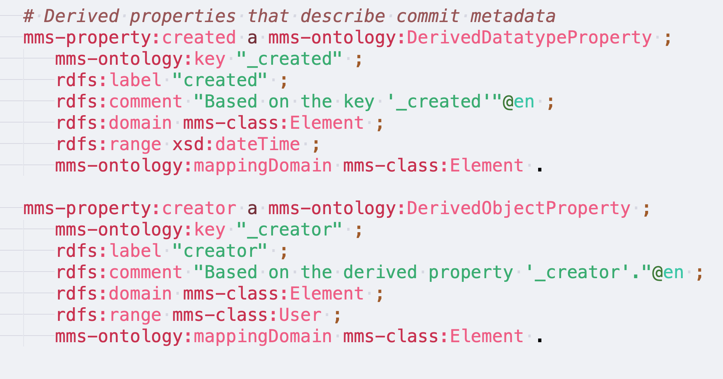
Derived Properties

Slide 18
Derived Properties cont’d
Integrating commit metadata into the graph (alongside model element data) will allow users to write queries based on arbitrary constraints from both the instance-data-level as well as the metadata-level (...plus the metamodel level).

Slide 19
3

Slide 20
Converting Model Element Data to RDF
Triplifier script ingests MMS’ serialization of the project and queries generated MMS ontology in order to transform each element to a set of RDF triples.
Each non-derived key of an object represents some specific UML property, but the label of the key does not uniquely identify the property. It also depends on the type of the element.

Slide 21
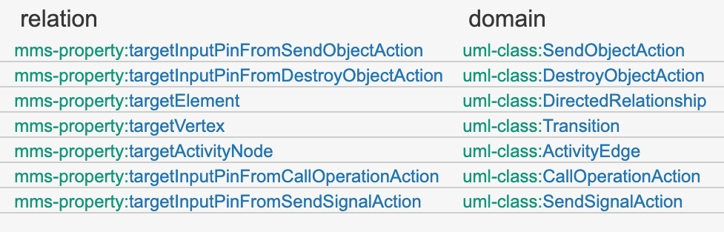
Properties that are candidates for “targetId” key

Slide 22
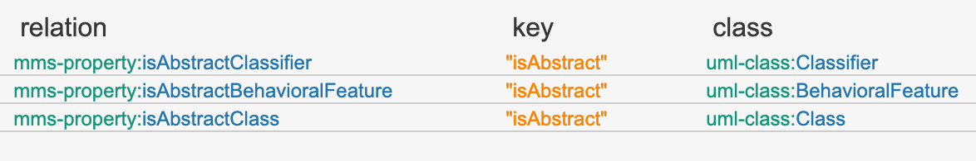
Properties that are candidates for “isAbstract” key

Slide 23
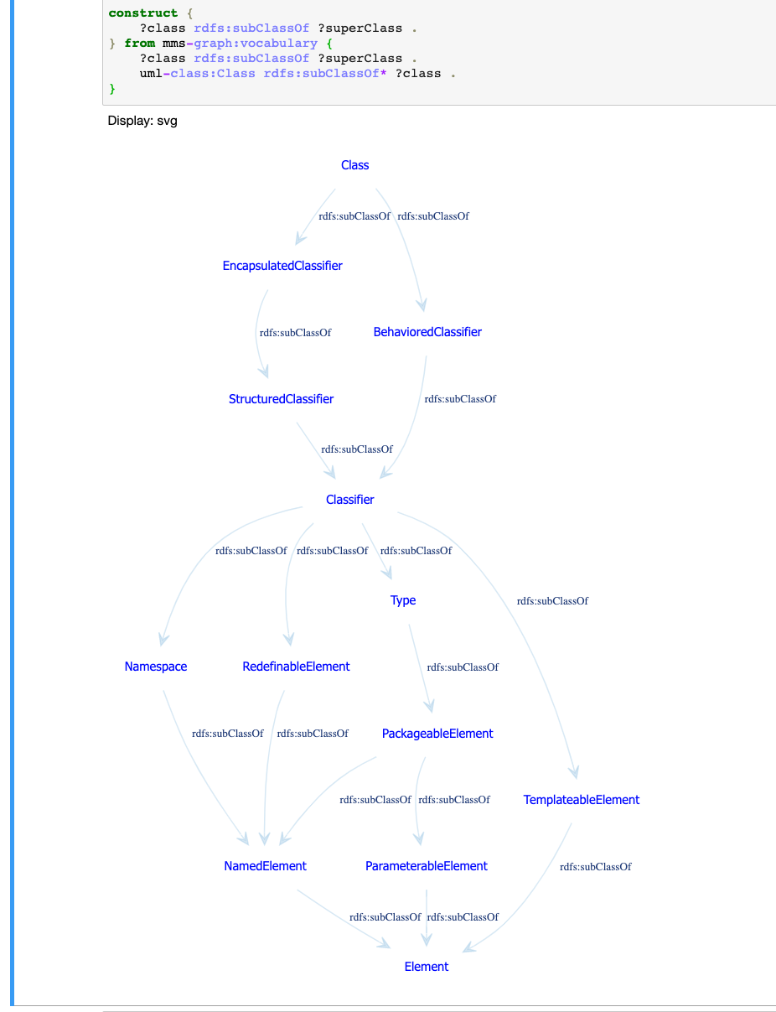
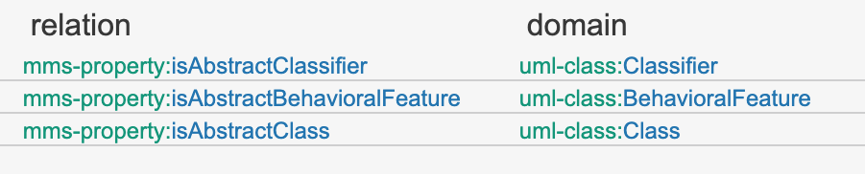
However, “Class” is a also subclass of “Classifier”...
Which relation should be used?
Need to choose the property with the domain that is most specific to the given element type.

Slide 24
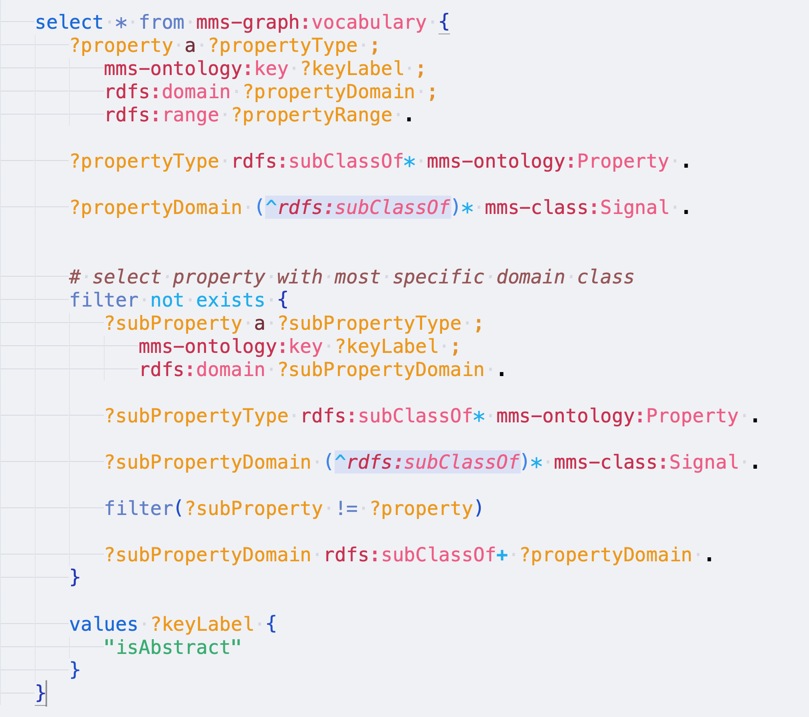

Slide 25
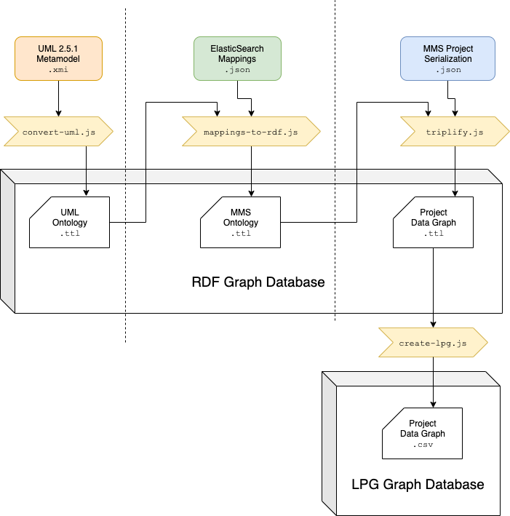
4

Slide 26
Labeled Property Graph
A shortcoming of the SPARQL query language is that it does not facilitate graph traversal queries, such as answering the question: “what is the shortest path between these two nodes?”
Gremlin is a graph traversal query language for labeled property graphs (LPGs).
The RDF graph-based data model cannot be mapped to LPGs without making some sacrifices (i.e., the transformation will inevitably be lossy).
For example, the ontology and metamodel are omitted from transformation since definitions for properties cannot link to the edges which instantiate them.

Slide 27
Labeled Property Graph cont’d
Instead, only the project data graph is converted to LPG as best they can.
Containers such as sets/lists of objects present a challenge; edges in LPGs can only have a single value so ordered lists must be reified as ad-hoc linked lists.
The linking of datatype nodes within RDF literals is lost in the transformation.
Cannot query for things that are a subClass of A, nor relations that are subProperties of P. Likewise, all inherent reasoning capability is lost.

